Slide 1
High-capacity Reversible Data-hiding for LZW Codes
Chair Professor Chin-Chen Chang
Feng Chia University
National Chung Cheng University
National Tsing Hua University
http://msn.iecs.fcu.edu.tw/~ccc

Slide 2
Outline
Information Hiding
Lempel-Ziv-Welch compression
The proposed scheme
Experimental results
Conclusions

Slide 3
Information Hiding
Sender
Receiver
Compression Code: <1><2><3><2>…
Cover Information
Reconstructed Information
Lincoln's Gettysburg Address
Fourscore and seven years ago our fathers brought forth on this continent a new nation, conceived in liberty and dedicated to the proposition that all men are created equal. Now we are engaged in a great civil war, testing whether that nation, or any nation so conceived and so dedicated, can long endure. We are met on a great battlefield of that war. We have come to dedicate a portion of that field as a final resting place for those who here gave their lives that that nation might live. It is altogether fitting and proper that we should do this.
Lincoln's Gettysburg Address
Fourscore and seven years ago our fathers brought forth on this continent a new nation, conceived in liberty and dedicated to the proposition that all men are created equal. Now we are engaged in a great civil war, testing whether that nation, or any nation so conceived and so dedicated, can long endure. We are met on a great battlefield of that war. We have come to dedicate a portion of that field as a final resting place for those who here gave their lives that that nation might live. It is altogether fitting and proper that we should do this.
Compression code
<1><2><3><2>…
Secret data: 011
Secret data: 011

Slide 4
Lempel-Ziv-Welch (LZW) compression
Encode the string
Dictionary
index | symbol
1 | a
2 | b
3 | ab
4 | ba
5 | abb
6 | baa
7 | abbb
8 | baaa
a b a b b a a b b b a a a b b b
LZW

Slide 5
LZW encoding rule
Encode the string
a b a b b a a b b b a a a b b b
Initial Dictionary
index | symbol
1 | a
2 | b
ab
is not in the Dictionary,
and inserted as new symbol
output prefix Code(a) = 1 as LZW compression code
last character b is remained for next symbol

Slide 6
LZW encoding
Encode the string
a b a b b a a b b b a a a b b b
Dictionary
index | symbol
1 | a
2 | b
3 | ab
ab
is not in the Dictionary,
and inserted as new symbol
output prefix
Code(a)=1
Output
<1>

Slide 7
LZW encoding
Encode the string
a b a b b a a b b b a a a b b b
Dictionary
index | symbol
1 | a
2 | b
3 | ab
4 | ba
ba
is not in the Dictionary,
and inserted as new symbol
output prefix
Code(b)=2
Output
<1><2>

Slide 8
LZW encoding
Encode the string
a b a b b a a b b b a a a b b b
Dictionary
index | symbol
1 | a
2 | b
3 | ab
4 | ba
5 | abb
abb
is not in the Dictionary,
and inserted as new symbol
output prefix
Code(ab)=3
Output
<1><2><3>

Slide 9
LZW encoding
Encode the string
a b a b b a a b b b a a a b b b
Dictionary
index | symbol
1 | a
2 | b
3 | ab
4 | ba
5 | abb
6 | baa
baa
is not in the Dictionary,
and inserted as new symbol
output prefix
Code(ba)=4
Output
<1><2><3><4>

Slide 10
LZW encoding
Encode the string
a b a b b a a b b b a a a b b b
Dictionary
index | symbol
1 | a
2 | b
3 | ab
4 | ba
5 | abb
6 | baa
7 | abbb
abbb
is not in the Dictionary,
and inserted as new symbol
output prefix
Code(abb)=5
Output
<1><2><3><4><5>

Slide 11
LZW encoding
Encode the string
a b a b b a a b b b a a a b b b
Dictionary
index | symbol
1 | a
2 | b
3 | ab
4 | ba
5 | abb
6 | baa
7 | abbb
8 | baaa
baaa
is not in the Dictionary,
and inserted as new symbol
output prefix
Code(baa)=6
Output
<1><2><3><4><5><6>

Slide 12
LZW encoding
Encode the string
a b a b b a a b b b a a a b b b
Dictionary
index | symbol
1 | a
2 | b
3 | ab
4 | ba
5 | abb
6 | baa
7 | abbb
8 | baaa
final output
Code(abbb)=7
Output
<1><2><3><4><5><6><7>
Compression Achieved
Message | codes | Bits / Code | Total
Original | 16 | 8 | 128 bits
LZW message | 7 | 3 | 21 bits

Slide 13
LZW decoding rule
Decode the string
<1><2><3><4><5><6><7>
Dictionary
index | symbol
1 | a
2 | b
3 | ab
4 | ba
5 | abb
6 | baa
7 | abbb
8 | baaa
Output
a b ab ba abb baa abbb
Output
Symbol(5)= abb
New symbol
= previous output || a
= baa

Slide 14
LZW decoding
Decode the string
<1><2><3><4><5><6><7>
Dictionary
index | symbol
1 | a
2 | b
3 | ab
Output
a b
Initial output
Symbol(1)=a
Symbol(2)=b
Insert symbol ab

Slide 15
LZW decoding
Decode the string
<1><2><3><4><5><6><7>
Dictionary
index | symbol
1 | a
2 | b
3 | ab
4 | ba
Output
a b ab
Output
Symbol(3)= ab
New symbol
= b || a

Slide 16
LZW decoding
Decode the string
<1><2><3><4><5><6><7>
Dictionary
index | symbol
1 | a
2 | b
3 | ab
4 | ba
5 | abb
Output
a b ab ba
Output
Symbol(4)= ba
New symbol
= ab || b

Slide 17
LZW decoding
Decode the string
<1><2><3><4><5><6><7>
Dictionary
index | symbol
1 | a
2 | b
3 | ab
4 | ba
5 | abb
6 | baa
Output
a b ab ba abb
Output
Symbol(5)= abb
New symbol
= ba || a

Slide 18
LZW decoding
Decode the string
<1><2><3><4><5><6><7>
Dictionary
index | symbol
1 | a
2 | b
3 | ab
4 | ba
5 | abb
6 | baa
7 | abbb
Output
a b ab ba abb baa
Output
Symbol(6)= baa
New symbol
= abb || b

Slide 19
LZW decoding
Decode the string
<1><2><3><4><5><6><7>
Dictionary
index | symbol
1 | a
2 | b
3 | ab
4 | ba
5 | abb
6 | baa
7 | abbb
8 | baaa
Output
a b ab ba abb baa abbb
Output
Symbol(7)= abbb
New symbol
= baa || a

Slide 20
The proposed scheme (1/5)
LZW
decoder
Cover
Cover
LZW
compression
code
Cover
HCDH-LZW
hiding scheme
HCDH-LZW
extracting scheme
Secret
Secret

Slide 21
The proposed scheme (2/5)
Hiding phase
  Hiding concept : shrink prefix s_{p} to hide secret
  n = length of s_{p}
  hide d = ⎣log₂ n⎦ bits in this LZW compression code
  Hiding rule
  v = value of d-bit secrets
  if v = 0, not change prefix s_{p}
  else shrink prefix s_{p} by v characters

Slide 22
The proposed scheme (3/5)
Dictionary
index | symbol
1 | a
2 | b
3 | ab
4 | ba
5 | abb
Example:
Encode the string
a b a b b a a b b b a a a b b b
prefix s_{p} = a b
n = 2
hide d = ⎣log₂ n⎦ = 1 bit
If secret bit =0, v=0 and not change prefix s_{p} = a b
If secret bit =1, v=1 and prefix s_{p} = a
Output
<3>
b
<1>

Slide 23
The proposed scheme (4/5)
Extracting phase
  Extracting concept : count decoded characters from following LZW compression code to extract secret
  s_{p}’ = decompressed symbol of LZW code,
  c₁c₂c₃… are the decoded string of following LZW codes
  Extracting rule
  if s_{p}’|| c₁c₂c₃..c_{v’} exists in the dictionary,
  length of secret = ⎣log₂ n⎦, n=length of s_{p}’|| c₁c₂c₃..c_{v’}
  and secret bits = binary form of v’

Slide 24
The proposed scheme (5/5)
Dictionary
index | symbol
1 | a
2 | b
3 | ab
4 | ba
5 | abb
Example:
Decode the string
<1><2><3><2><1><5><2>
Output
a b ab b a abb
s_{p}’= b
aabb is the decoded string of following LZW codes
since b a exists in the dictionary,
length of secret = ⎣log₂ n⎦ =1, n=length of ba=2
v’= 1
and secret bits = binary form of v’ = 1

Slide 25
Simulation
Cover message: “ababbaabbbaaabbb”
Secret message: “0101000”
Hiding
Input | Original LZW code | Output | Dictionary |  | Hidden secret
 |  |  | 1 | a
 |  |  | 2 | b
ab | 1(a) | 1(a) | 3 | ab
a | 2(b) | 2(b) | 4 | ba
bb | 3(ab) | 3(ab) | 5 | abb | 0
aa | 4(ba) | 2(b) | 6 | ba | 1
 | 1(a) | 1(a) | 7 | aa
bbb | 5(abb) | 5(abb) | 8 | abbb | 0
aa | 4(ba) | 2(b) | 9 | ba | 1
a | 7(aa) | 7(aa) | 10 | aaa | 0
bbb | 8(abbb) | 8(abbb) | 11 | abbb | 00
Extracting
Input | Output | Dictionary |  | Extracting secret
 |  | 1 | a
 |  | 2 | b
1 | a | 3 | ab
2 | b | 4 | ba
3 | ab | 5 | abb | 0
2 | b | 6 | ba | 1
1 | a | 7 | aa
5 | abb | 8 | abbb | 0
2 | b | 9 | ba | 1
7 | aa | 10 | aaa | 0
8 | abbb | 11 | abbb | 00

Slide 26
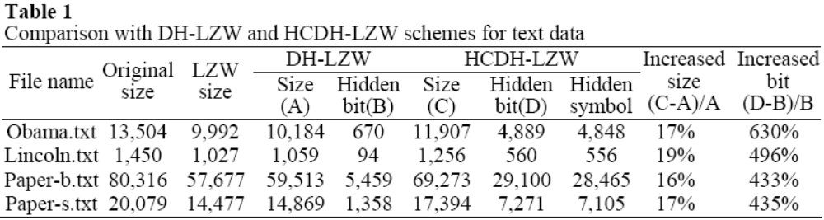
Experimental results (1/2)

Slide 27
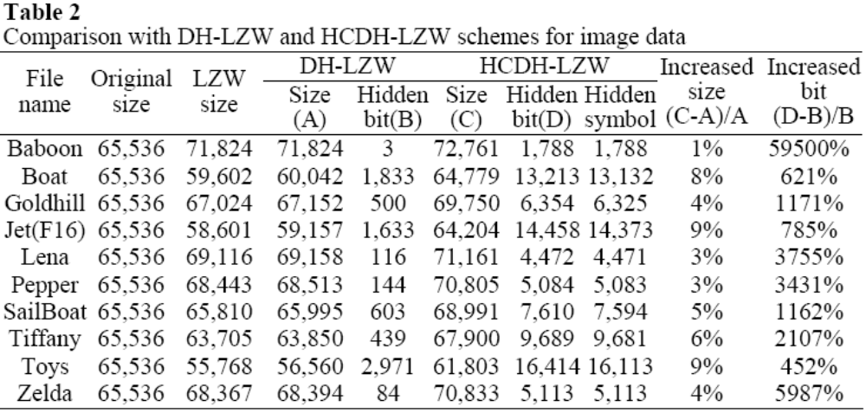
Experimental results (2/2)

Slide 28
Conclusions
Hide secrets in LZW compression codes
High hiding-capacity
Transmission codes still LZW compression codes
Recovering cover information do not need extra message, like location map

Slide 29
Thanks for your listening

